Slide 1
Noise (Electrical)
PHY2250 Electronics & Circuit Theory

Slide 2
“Noise”
Definition: For our purposes, “noise” is any ‘unwanted’ contribution to a “signal”
Unlike other discussions of noise, we do not require ‘noise’ to be random.
Rather, it could simply be an additional audio waveform which interferes with our intended signal
“Hum” also counts as “noise” for this discussion

Slide 3
Noise Sources
Main sources:
Poor ground - “60 Cycle Hum”
‘Other’ circuits turning off & on
Induced via electromagnetic fields

Slide 4
Signal-to-Noise Ratio (SNR)
“the ratio of the strength of an electrical or other signal carrying information to that of interference, generally expressed in decibels.”
Wikipedia
SNR (dB) = 10 log₁₀ (Power_{Signal} / Power_{Noise} )
= 10 log₁₀ (V_{Signal}² / V_{Noise}² )
= 20 log₁₀ (V_{Signal} / V_{Noise} )

Slide 5
Noise Countermeasures
“Good ground”
Common Mode Rejection
“Choke”: Low-Pass Filter.
Smart cable practices

Slide 6
Good Ground
Signal is typically a voltage, which is a potential difference
If noise is on both “signal” and “ground”, it subtracts out!
Recall improvements via using ground clip on scope
Multiple components should be on same circuit (e.g., “amp fighting” in Taylor video)
Can also Isolate (“ground lift”) via transformer

Slide 7
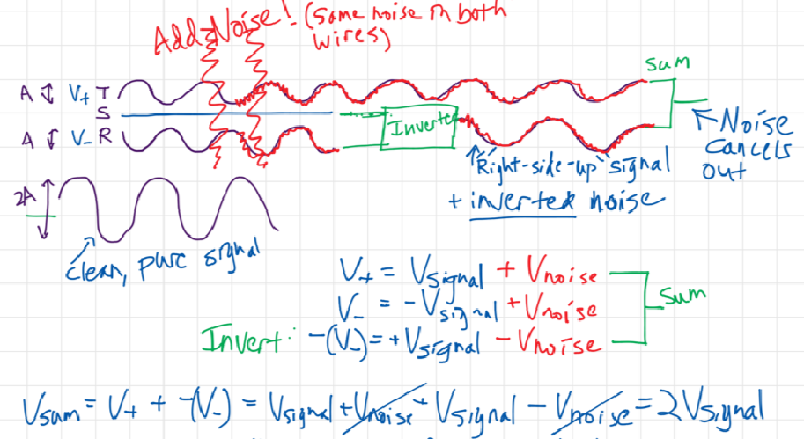
Common Mode Rejection
Featured in
Differential amplifier
Balanced connection: Same signal on two wires, but one is inverted; then invert again & sum
Course notes:

Slide 8
Choke
A choke is a Low-Pass Filter (LPF)
Since noise is typically high-frequency, running a LPF can often help significantly improve SNR
A choke is typically a single inductor placed in series with the signal
Fancier chokes may use one or more inductors in series with main signal flow, possibly combined with capacitor in parallel:
More on chokes, from guitar amp manufacturer:
http://www.aikenamps.com/index.php/chokes-explained

Slide 9
Smart Cable Practices
Alternate (/Reverse) the Winding Direction of Coils
Used to reduce E/M interference
Examples:
“Over/under” cable wrap – also puts lets stress on wires in cable, plus allows for easy uncoiling.
Humbucker guitar pickups
Don’t mix power & ‘data’/’signal’ cables
i.e., don’t have them near each other
Cross at right angles rather than run parallel

